Slide 1
The Dangers of Storytelling with
Feature Importance
PyData NYC 2023
Roni Kobrosly Ph.D.

Slide 2
Today’s talk
What is a “model data story”?
Feature importance in a minute
Correlation and causation and ice cream
The problem of confounding
Ice cream and crime
What good are feature importance metrics anyways?
Parsimonious models and mathematical explainability
Causal feature importance through Meta Learners
A closer look at customer churn, with a DAG
Prepping for Meta Learning
The simplest Meta Learner (S-Learner) explained three ways
Alternative Meta Learners
The causalml package API
Average and heterogenous importance
There is no free lunch

Slide 3






An, unfortunately, common data science workflow
Discuss churn problem with stakeholder team
Exploratory data analysis
Train and
evaluate model
Socialize story with stakeholders, with recommendations for reducing churn
Create “data story” from model and feature importance values
Estimate feature importance

Slide 4
An, unfortunately, common data science workflow
Discuss churn problem with stakeholder team
Exploratory data analysis
Train and
evaluate model
Socialize story with stakeholders, with recommendations for reducing churn
Create “data story” from model and feature importance values
Estimate feature importance

Slide 5
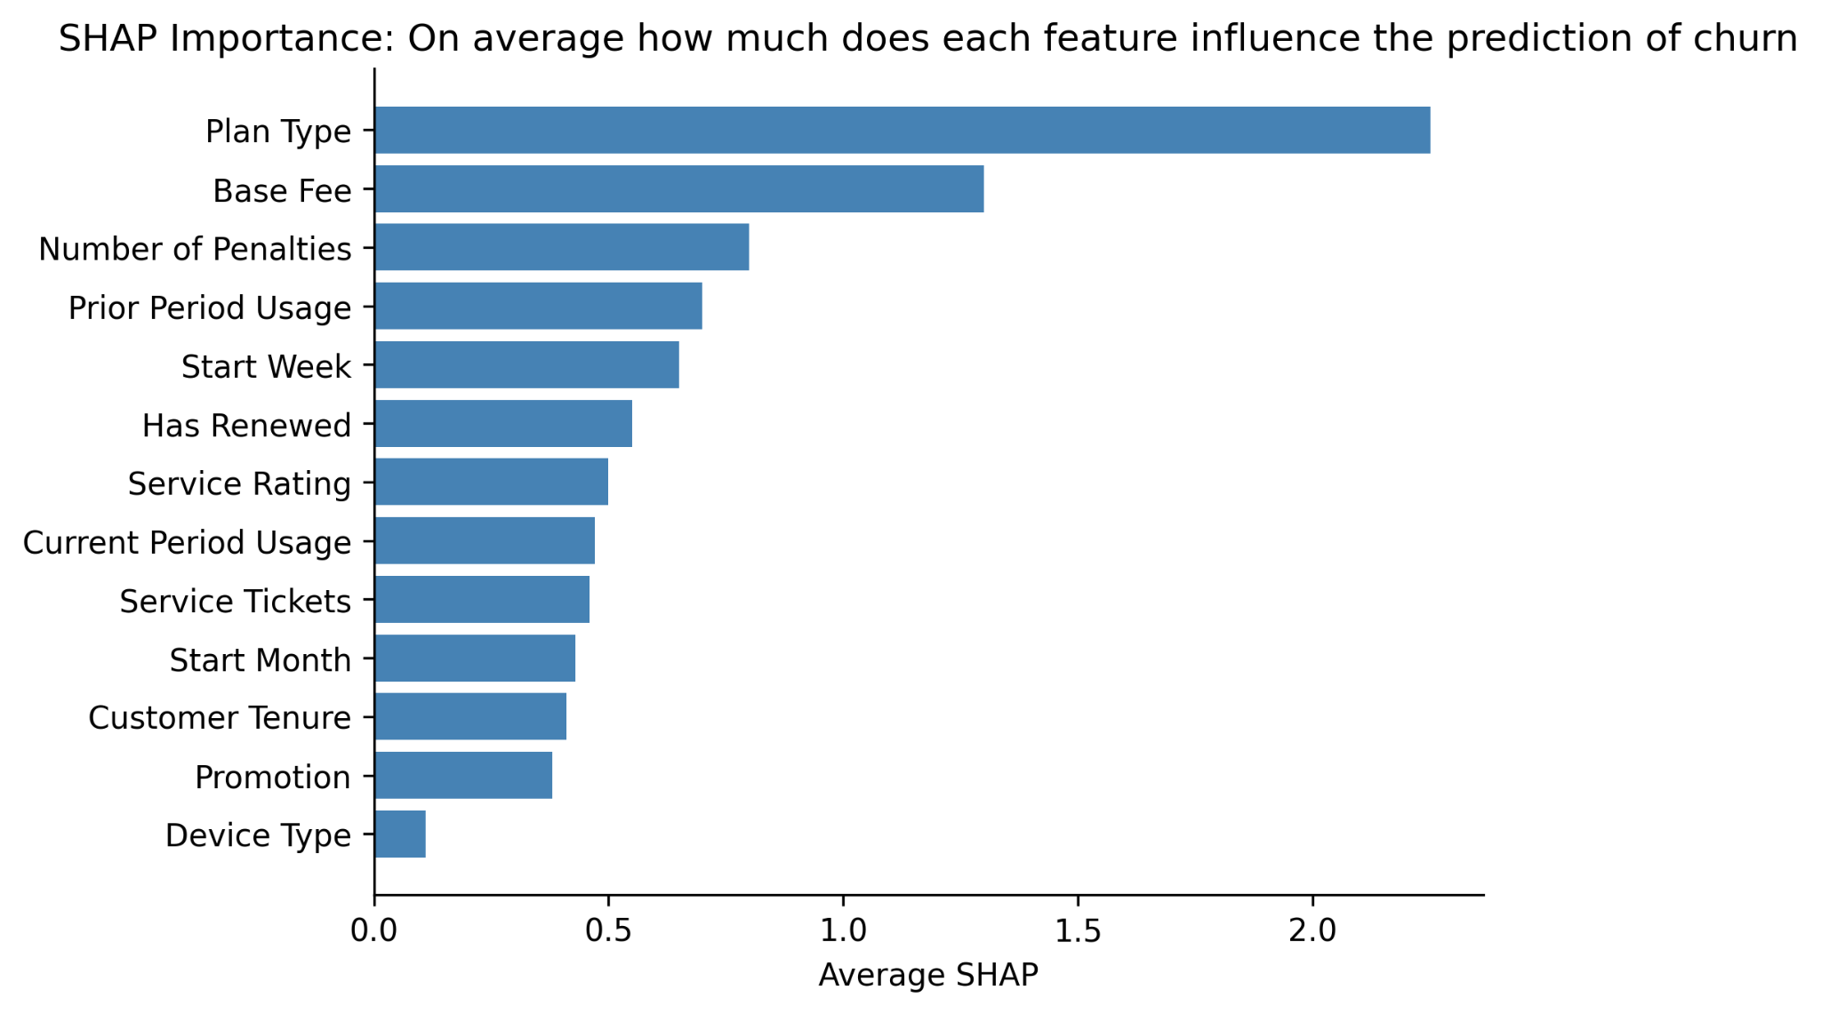


Slide 6
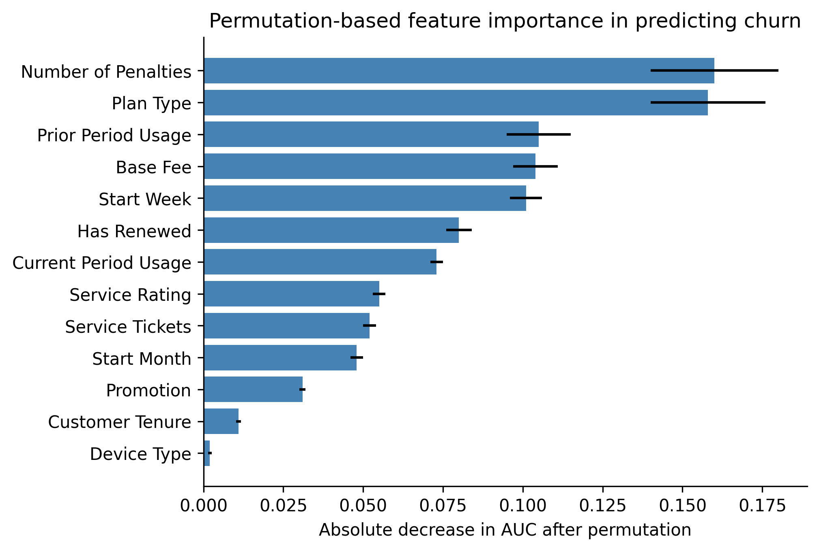


Slide 7
The problem of confounding
Confounder
X
Y

Slide 8
Summer weather induces a false association between ice cream sales and crime
//
Hot Weather
Ice cream sales
Crime Rate

Slide 9
Creating a toy dataset to illustrate this
Day of Week
Population Density
Income Inequality
Temperature
Median Income
/
Ice Cream Sales
# crimes committed

Slide 10
Let’s say we don’t have access to temperature in your dataset
Day of Week
Population Density
Income Inequality
Temperature
Median Income
/
Ice Cream Sales
# crimes committed

Slide 11
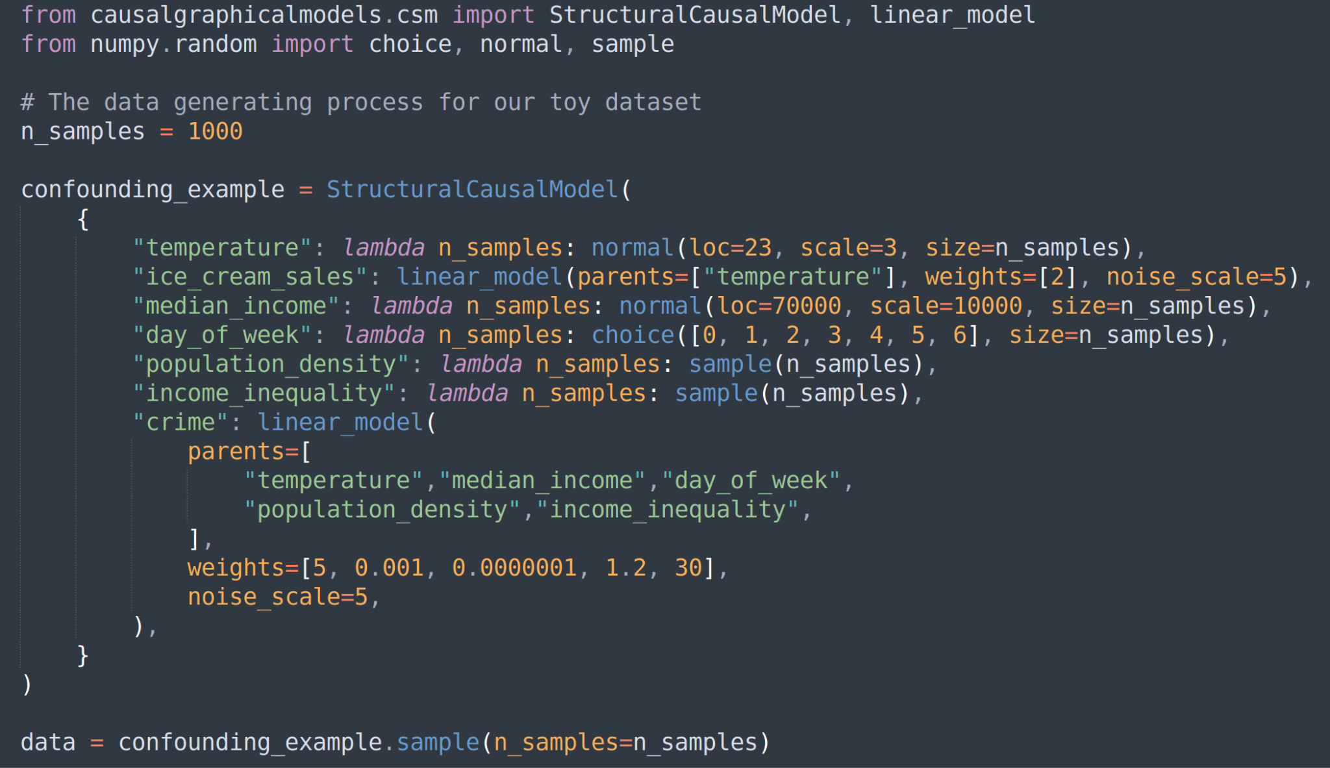

Slide 12
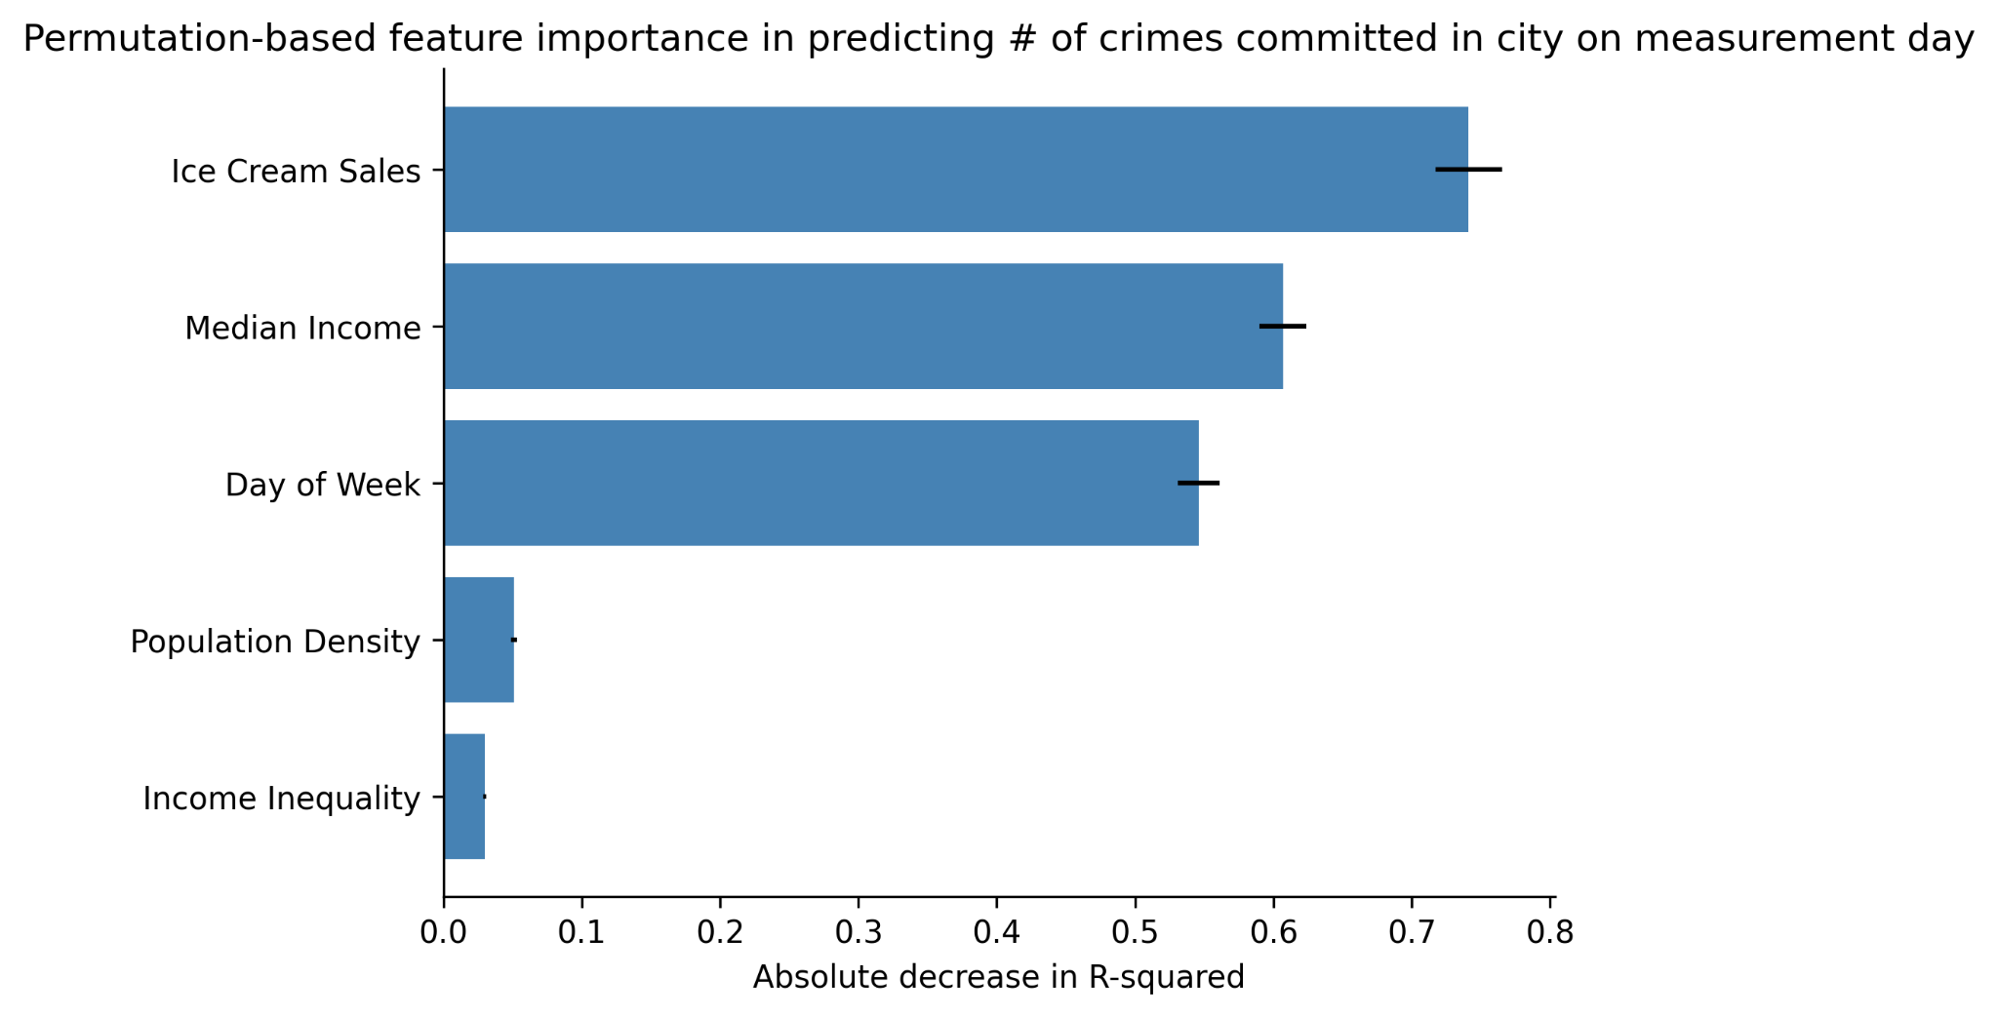

Slide 13
Feature importance measures aren’t causal but they still serve a purpose!
Feature pruning
If you don’t care about actionable insights, prune features that contribute little predictive power
Simplifies your ETL
Explainability of predictions
Remember, this is not causal explainability, but rather mathematical explainability
E.g. “The model said this person shouldn’t be approved for a credit card because X was high, Y was low, and Z was low, and based on the model weights this produced a low outcome score.”

Slide 14
If you have a predictive model and really want to estimate the causal importance of features…
Enter: Meta Learners

Slide 15
However, before we do any modeling
Take stock of all of the variables/features at your disposal
You need to whiteboard out a proposed causal relationships between all features (like we did on the earlier slide with crimes per day)
Use your domain knowledge for this
You need to binarize all features
With continuous variables: assign 0 if below median values, assign 1 if above median value
With ordinal or nominal variables: create dummy variables
For each feature you’ll need to determine its specific set of confounders
Note which features are actionable / intervenable

Slide 16
‘
Age
# outages in last week
# customer service calls
Plan
Type
Usage
per day
Satisfaction
(survey)
Tenure
Churn
Regional
coverage

Slide 17
Confounders for a given feature
Tenure: ( )
Usage per day: (age)
Age: ( )
Plan type: (age)
Satisfaction: (plan type, regional coverage)
Regional coverage: ( )
# outages last week: ( )
# customer service calls: (# outages last week, plan type, regional coverage)

Slide 18
The simplest Meta Learner: S-Learner

Slide 19
1) Start with a set of participants for whom we have complete data on the feature of interest, outcome, and confounder data
Cust ID# | Confound 1 | Confound 2 | Feature | Churn
1 | 1 | 0 | 1 | 0
2 | 1 | 0 | 1 | 0
3 | 0 | 0 | 0 | 0
4 | 1 | 0 | 0 | 1
5 | 1 | 1 | 1 | 0

Slide 20
2) Train a model that predicts the outcome from all confounders and feature of interest. Aim for high recall and precision.
Cust ID# | Confound 1 | Confound 2 | Feature | Churn
1 | 1 | 0 | 1 | 0
2 | 1 | 0 | 1 | 0
3 | 0 | 0 | 0 | 0
4 | 1 | 0 | 0 | 1
5 | 1 | 1 | 1 | 0

Slide 21
3) Copy your dataset, and in the new version force the values of feature variable to be “1” for all observations
Cust ID# | Confound 1 | Confound 2 | Feature | Churn
1 | 1 | 0 | 1 | 0
2 | 1 | 0 | 1 | 0
3 | 0 | 0 | 1 | 0
4 | 1 | 0 | 1 | 1
5 | 1 | 1 | 1 | 0

Slide 22
4) Predict outcome values using the model you trained, and with the new feature values and same confounder values
Cust ID# | Confound 1 | Confound 2 | Feature | Churn | Prob₁
1 | 1 | 0 | 1 | 0 | 0.55
2 | 1 | 0 | 1 | 0 | 0.45
3 | 0 | 0 | 1 | 0 | 0.67
4 | 1 | 0 | 1 | 1 | 0.28
5 | 1 | 1 | 1 | 0 | 0.51

Slide 23
5) Copy the original dataset, and now force all features to take on values of “0”. Use that same earlier model to predict outcome values with these new feature values.
Cust ID# | Confound 1 | Confound 2 | Feature | Churn | Prob₀
1 | 1 | 0 | 0 | 0 | 0.44
2 | 1 | 0 | 0 | 0 | 0.42
3 | 0 | 0 | 0 | 0 | 0.80
4 | 1 | 0 | 0 | 1 | 0.26
5 | 1 | 1 | 0 | 0 | 0.43

Slide 24
6) For each observation, calculate the delta in the outcome. Average these deltas together to get the overall effect size. You can treat this as the average causal effect of the feature on the outcome.
Cust ID# | Prob₁ | Prob₀ | Δ
1 | 0.55 | 0.44 | 0.11
2 | 0.45 | 0.42 | 0.03
3 | 0.67 | 0.80 | -0.13
4 | 0.28 | 0.26 | 0.02
5 | 0.51 | 0.43 | 0.08
𝜇_{Δ} = 0.02

Slide 25
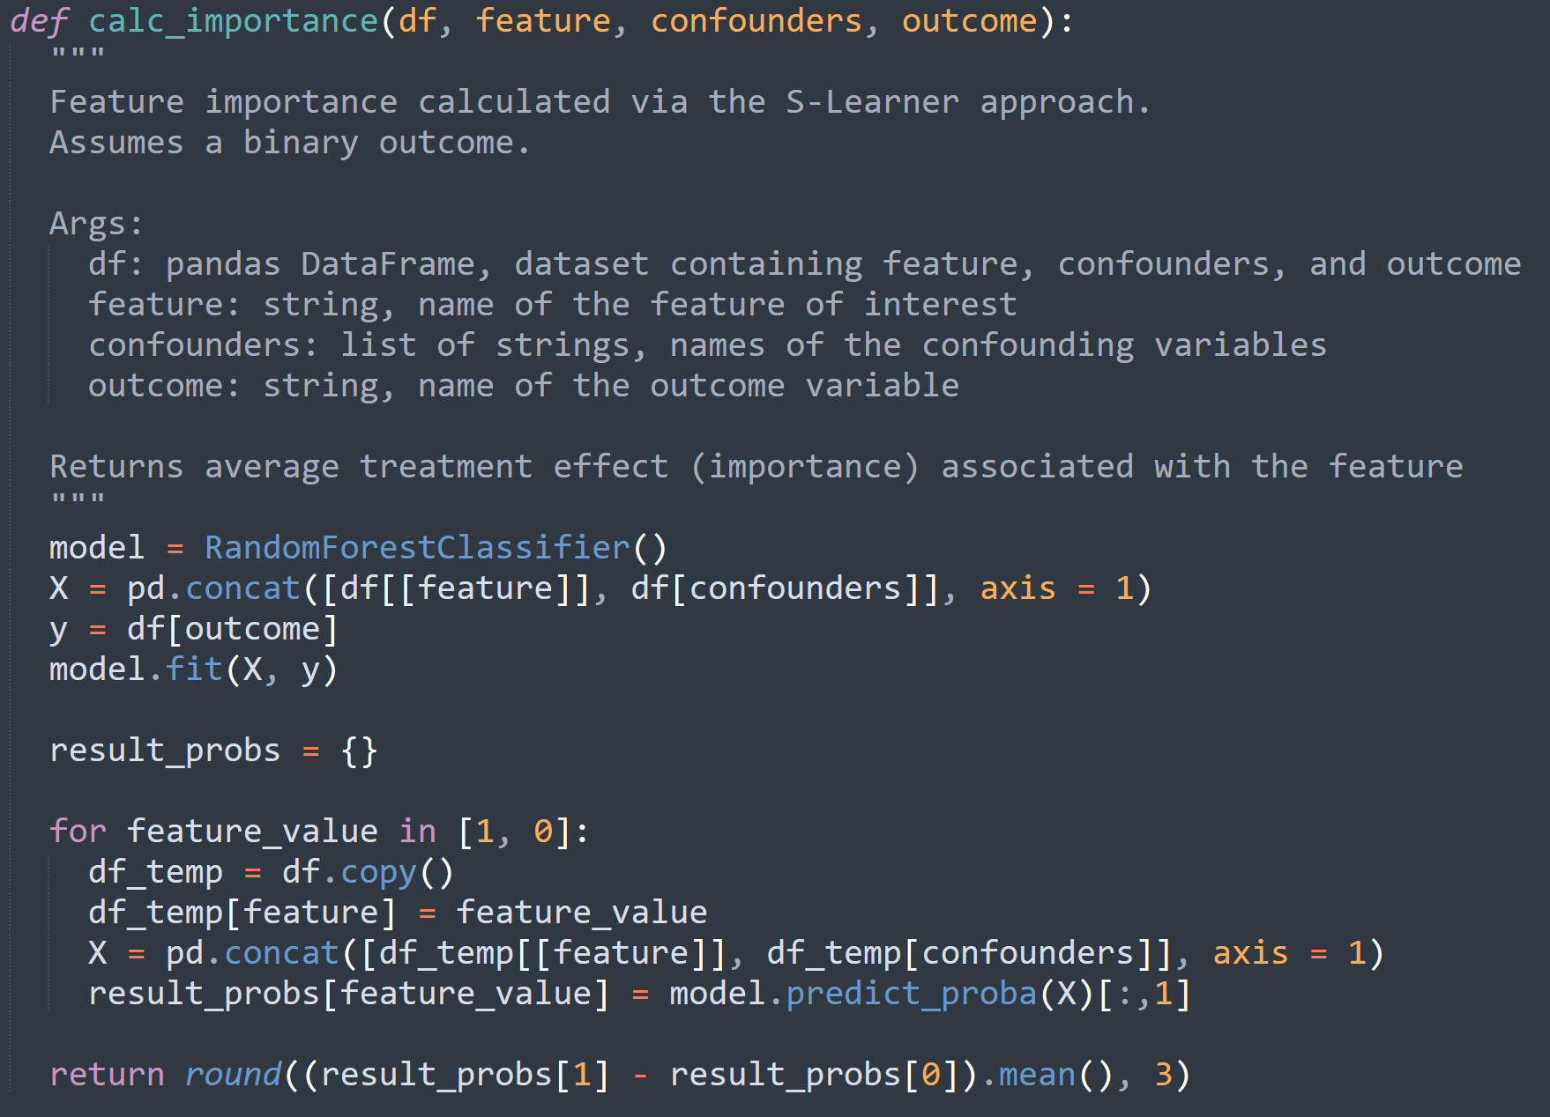

Slide 26
S-Learner diagrammed
Training
Predicting
C
C
F = 1
F = 0
C
Y
Y
Model
F
Y
Model
p_{Y} | F=1
p_{Y} | F=0
𝜇_{Δ} = Average effect
Adapted from Alves MF, “Causal Inference for the Brave and True”, 2022

Slide 27
T-Learner diagrammed
Predicting
Training
F=1
F=0
F=1
C
C
C
Model_{F=1}
Y
Y
Y
C
F
F=0
Model_{F=1}
Model_{F=1}
Y
C
Model_{F=0}
Y
p_{Y} | F=1
p_{Y} | F=0
𝜇_{Δ} = Average effect
Adapted from Alves MF, “Causal Inference for the Brave and True”, 2022

Slide 28
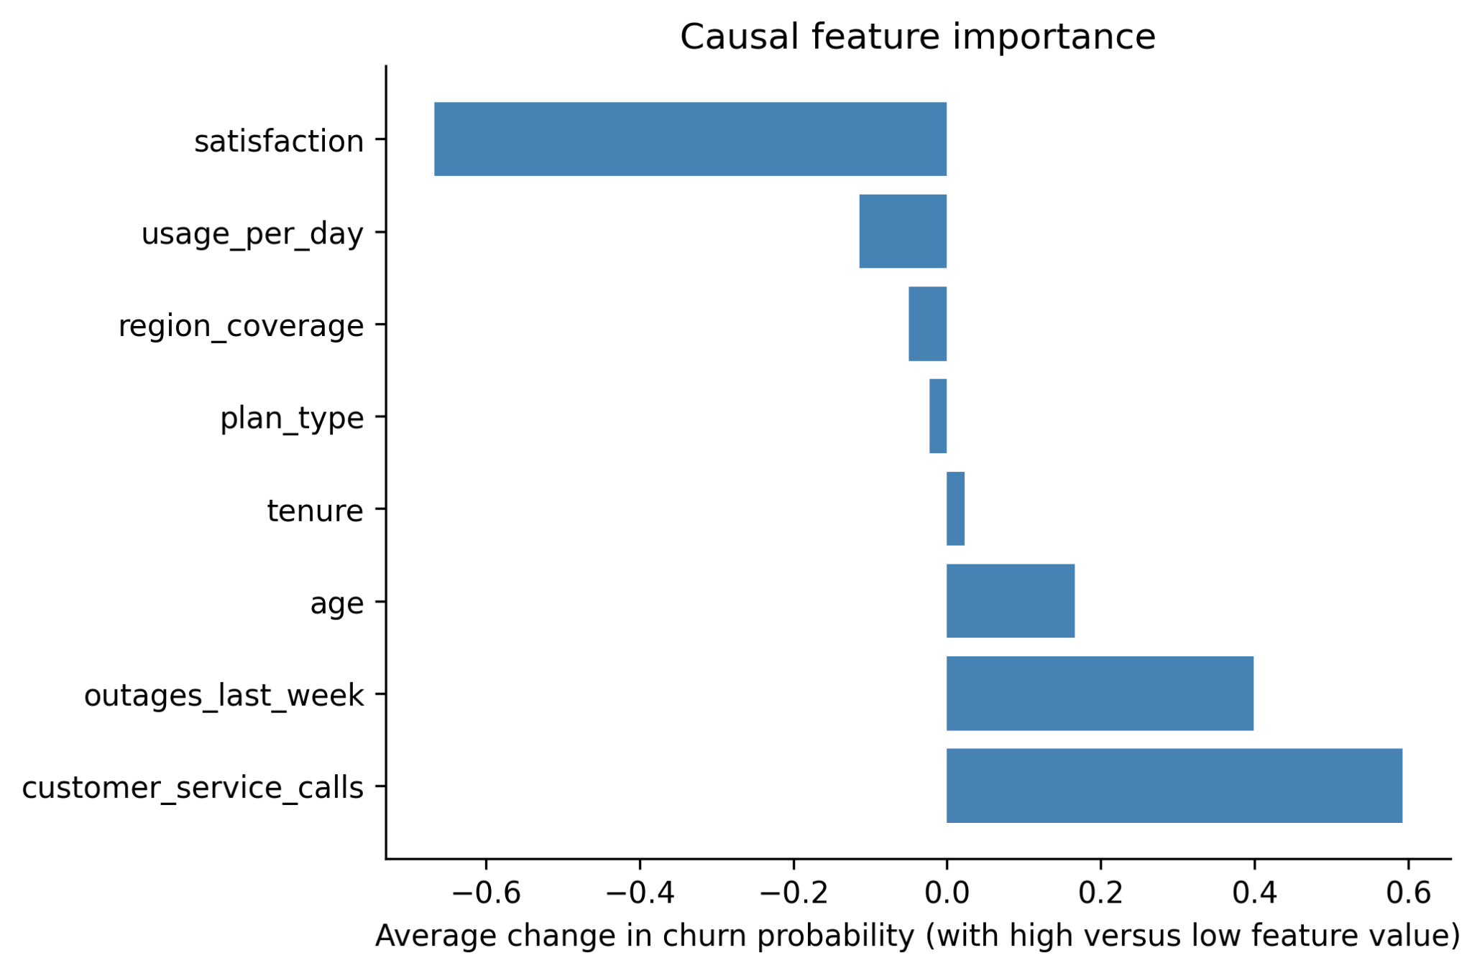

Slide 29
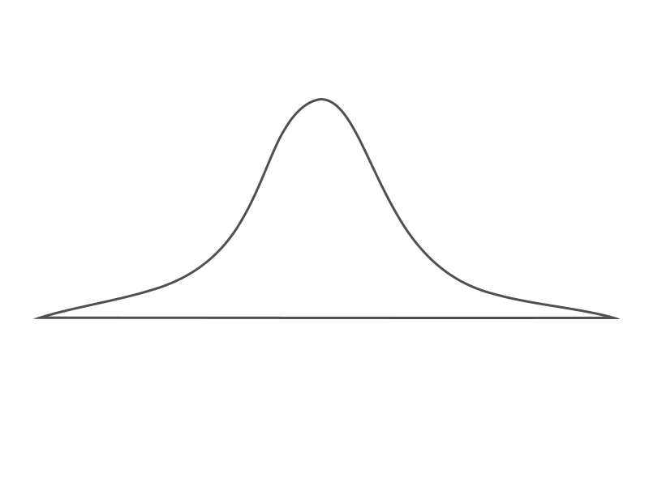
You can get confidence intervals via bootstrapping
Sample full N with replacement 1000 times
Run 1000 datasets through feature importance function to obtain distribution of importance values
Calculate mean, standard error, and finally confidence interval
Causal
Feature
Importance
Function
C
I_{F} = 0.15
(95% CI: 0.10 - 0.20)
F
I_{F} values
Y
S-Learner Model

Slide 30
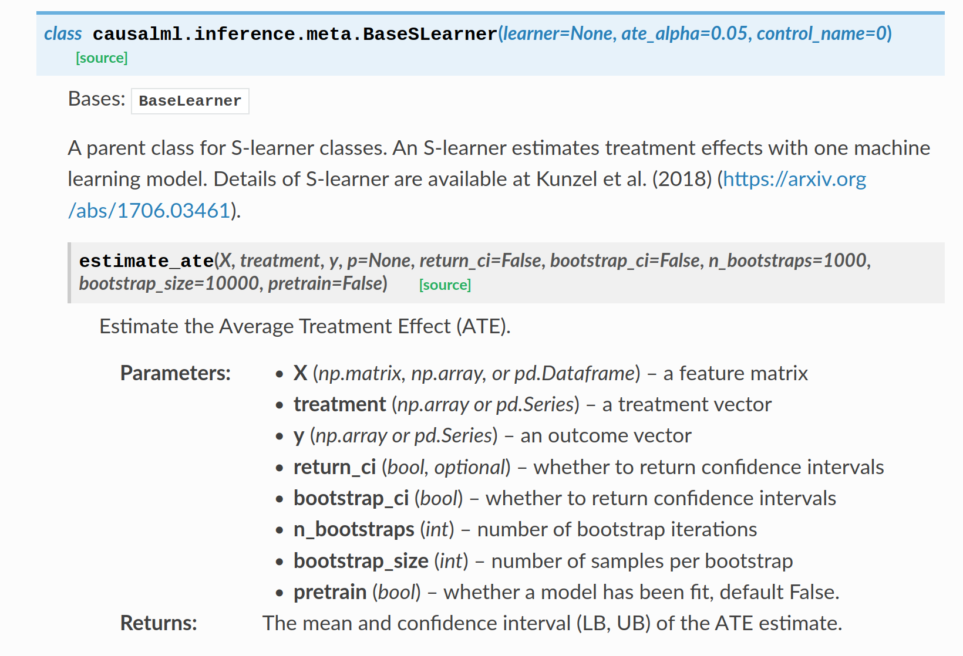


Slide 31
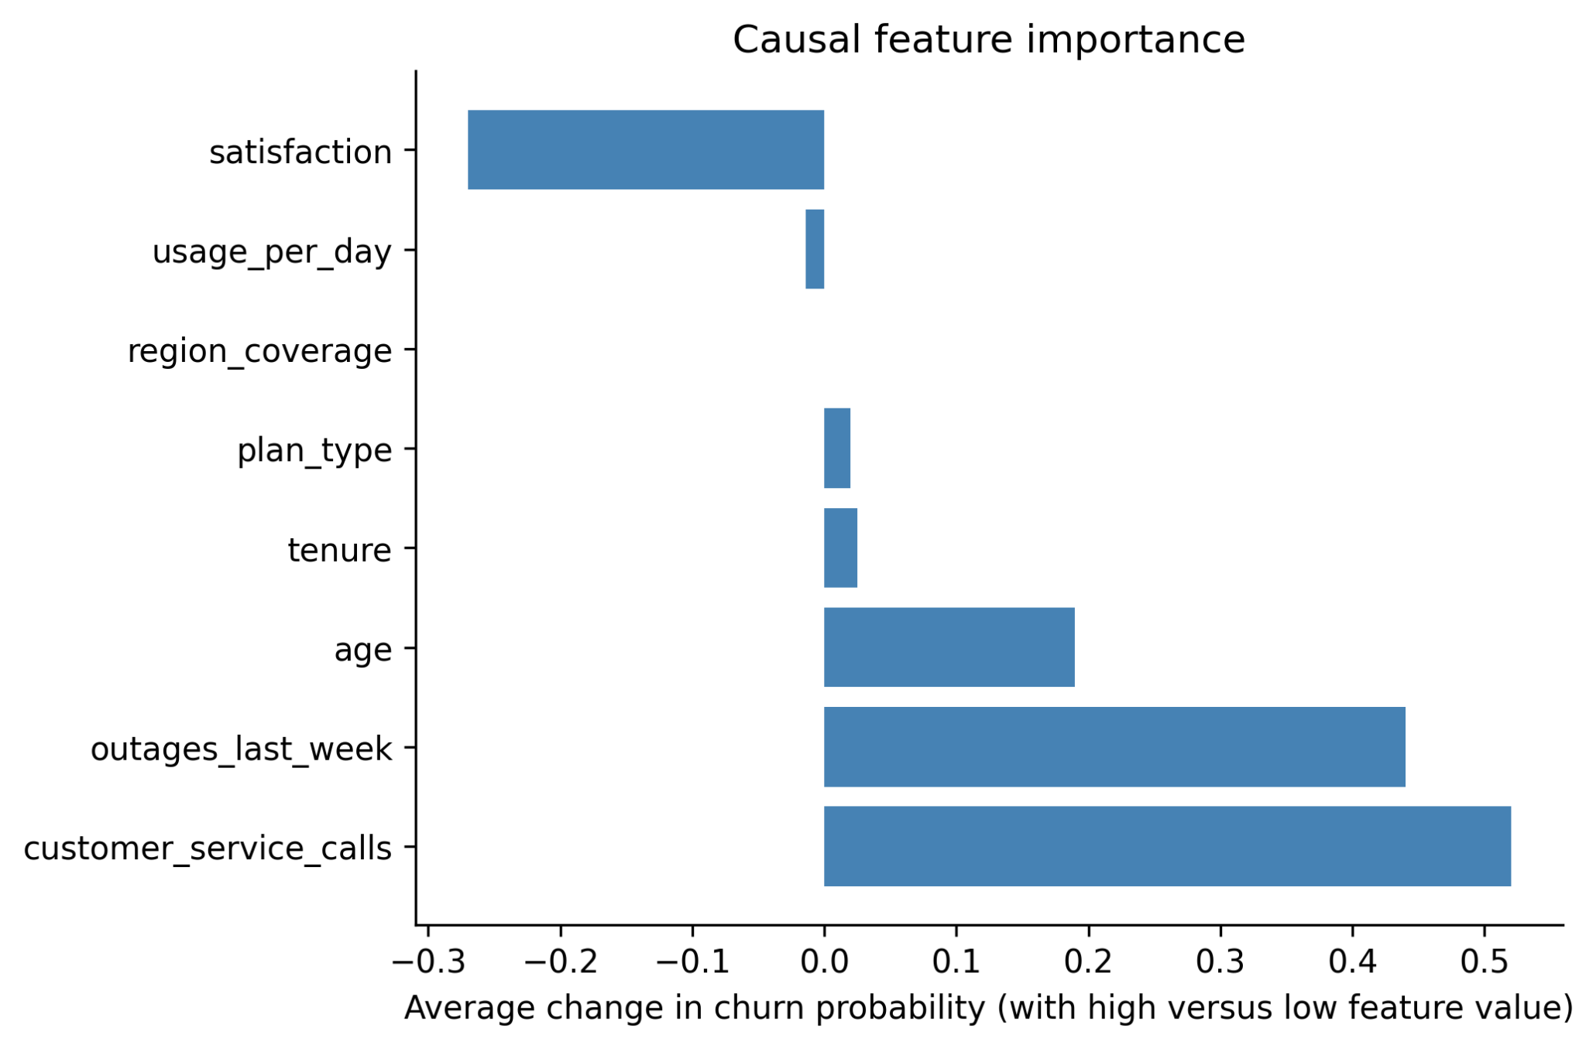
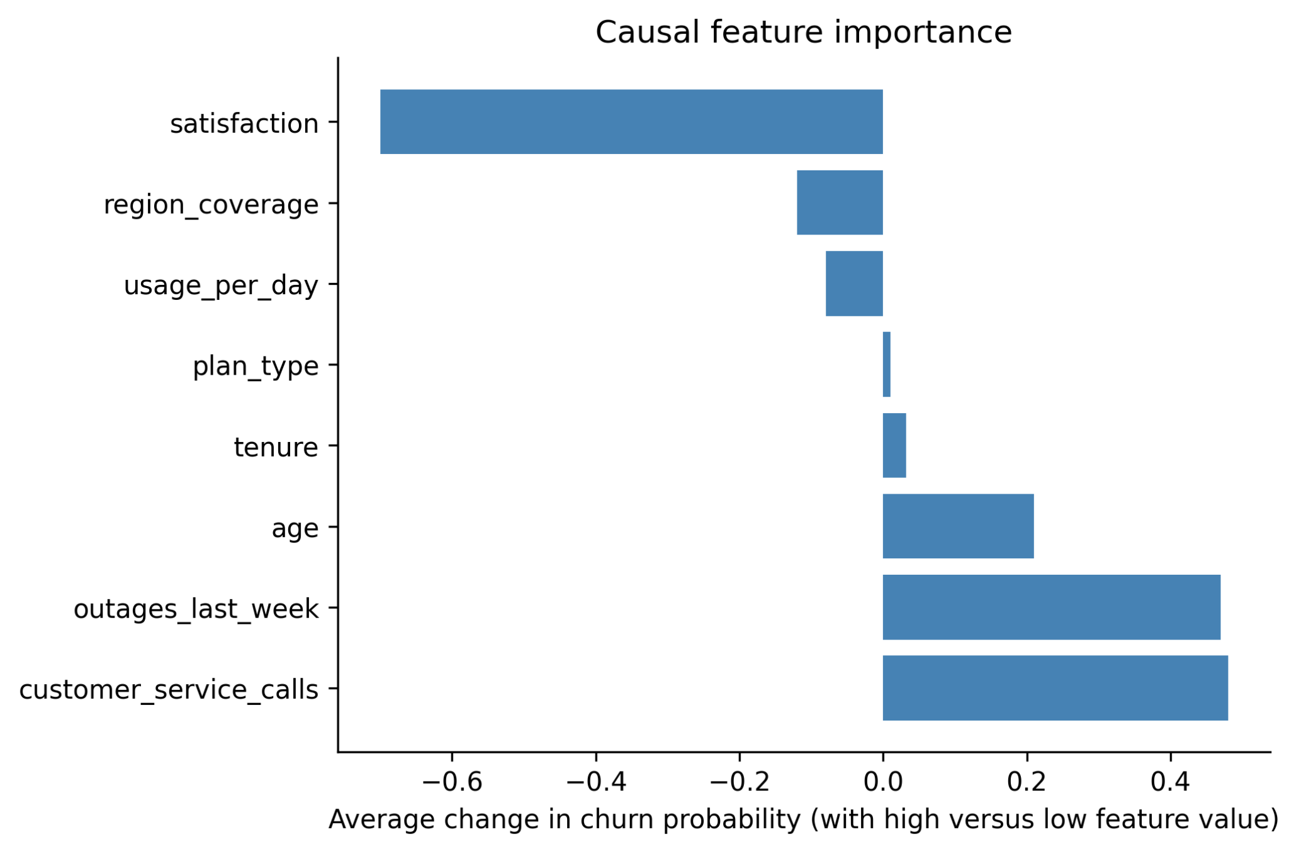
Can get causal feature importance for entire population, subgroups, or even individual observations
Causal
Feature
Importance
Function
Subpop A
Subpop B
Full
S-Learner Model

Slide 32
There is no free lunch, causal assumptions must be met
Temporally, the feature must have occurred before outcome.
The feature value of one observation must not have an effect on the outcomes of another observation.
For a given feature, there needs to be some variability in its values and outcome values across the confounder values.
All major confounding variables are included in your analysis. This is generally impossible to meet, but in practice you try the best you can to minimize the violations of this.

Slide 33
Thank you.
Any questions?

